Slide 1
Medical Insurance Cost Prediction
Project Overview and Key Insights
PRAGADEESHWARAN B

Slide 2
Introduction
• Objective: Predict medical insurance costs using ML.
• Dataset: Includes age, sex, BMI, children, smoker, and region.
• Tools: Python, EDA, Scikit-learn, MLflow, Streamlit.

Slide 3
Data Preprocessing
• Missing value treatment
• Encoding categorical variables
• Feature scaling
• BMI categorization

Slide 4
Exploratory Data Analysis (EDA)
• Univariate, Bivariate, and Multivariate analysis
• Outlier detection
• Correlation analysis

Slide 5
Model Training & Evaluation
• Models: Linear Regression, Ridge Regression, Decision Tree, Random Forest, XGBoost
• Metrics: R², RMSE,MAE
• Best Model: Decision Tree (R² ≈ 0.892)

Slide 6
MLflow Integration
• Tracked experiments, metrics, models
• Best model registered

Slide 7
Streamlit Web App
• Introduction page with project details
• Interactive EDA page with visualizations
• Prediction page with real-time cost estimation

Slide 8
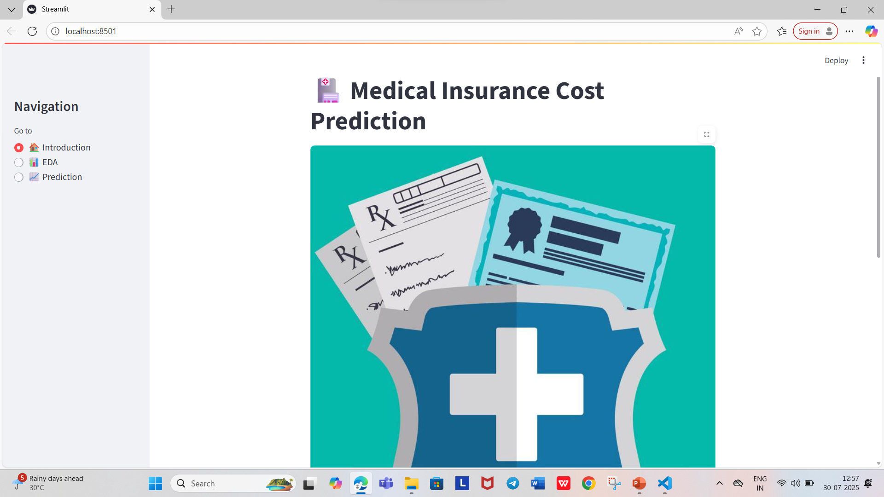
Streamlit view and MLFlow ui view

Slide 9
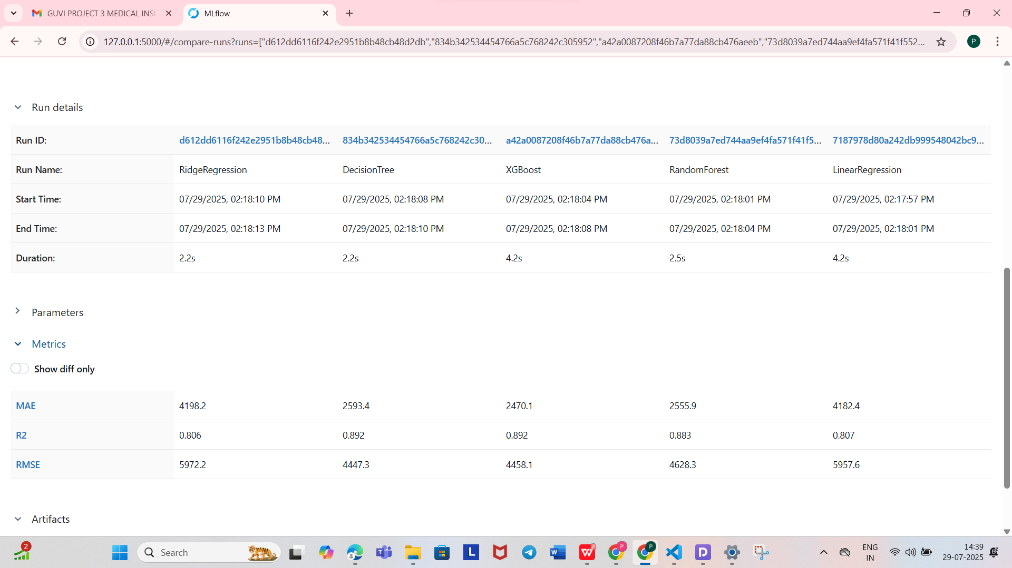

Slide 10
Conclusion
• Successfully built an end-to-end ML solution
• Predicts medical insurance charges with good accuracy
• Provides business insights and visualization capabilities

